Slide 1
SQL AND DATABASES PROJECT REPORT QUARTERLY BUUSINESS REPORT OF NEW WHEELS VEHICLE RESALE COMPANY
BY
NAME : SOMDEB PRAMANIK
BATCH : PGP DSBA (GREAT LEARNING)[Feb23.B G2]

Slide 2
BUSINESS OVERVIEW
METRIC OF INTEREST | VALUE
TOTAL REVENUE | 83115001.11
TOTAL ORDERS | 1000
TOTAL CUSTOMERS | 994
AVERAGE RATING | 3.1350
LAST QUARTER REVENUE | 15280009.98
LAST QUARTER ORDERS | 199
AVERAGE DAYS TO SHIP | 98 (OVERALL), 174 (LAST QTR)
GOOD FEEDBACK (%) | 44.1 (OVERALL) 20.1 (LAST QTR)

Slide 3
CUSTOMER METRICS

Slide 4
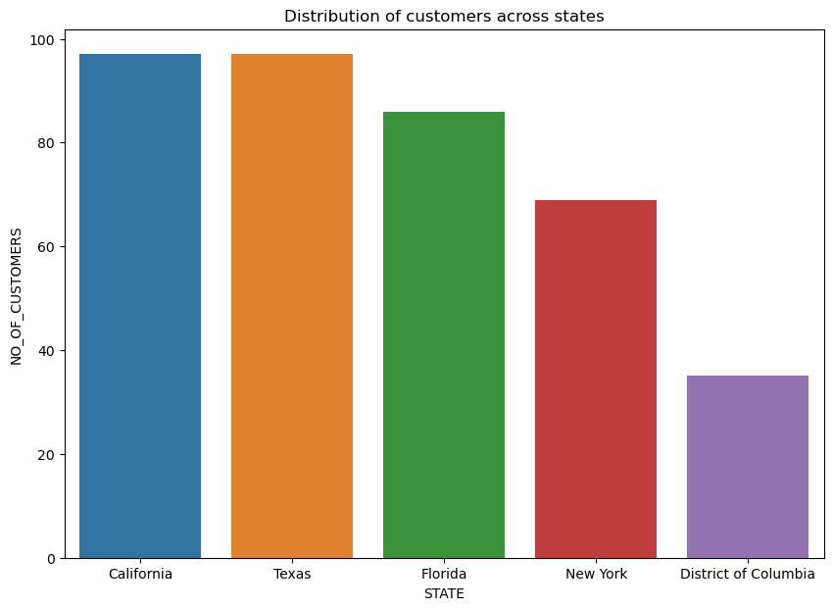
DISTRIBUTION OF CUSTOMERS ACROSS STATES
OBSERVATIONS AND FINDINGS
The top five states in terms of the maximum number of customers can be seen here.
The maximum number of customers are from the states of California and Texas, followed by Florida, New York and District of Columbia.
Therefore in order to revive the business, the company should look forward to campaigns in other states and try to fetch more customers from there also in the future without allowing the customer base from the above mentioned regions from getting adversely affected.

Slide 5
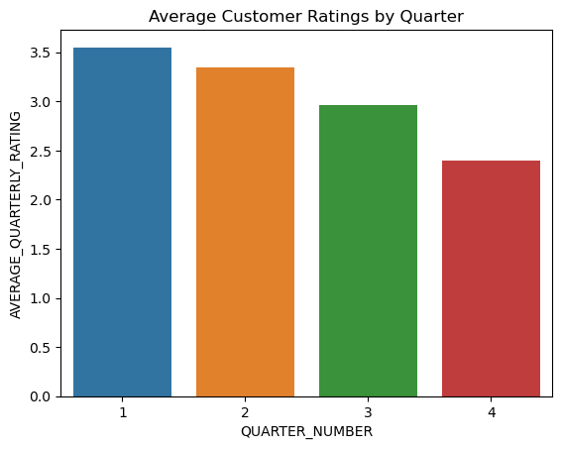
AVERAGE CUSTOMER RATINGS BY QUARTER
OBSERVATIONS AND FINDINGS
It can be clearly seen from the attached plot that the average rating / feedback from the customers have continuously degraded from 3.5 to around 2.5 across the 4 quarters chronologically.
The company must look into the poor feedbacks and address the specific details available there related to the service provided by the company in these 4 quarters.

Slide 6
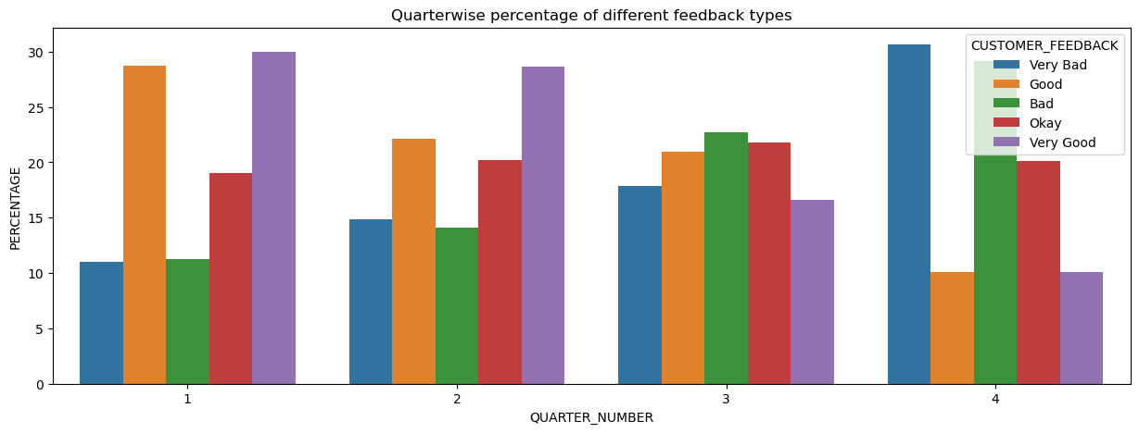
TREND OF CUSTOMER SATISFACTION
OBSERVATIONS AND FINDINGS
Two noticeable features from the above plot are – the percentage of ‘very good’ feedbacks have gone down and the percentage of ‘very bad’ feedbacks have gone up from every quarter to the successive one.
Both these have eventually contributed to the overall customer rating continuously going down across the 4 quarters. Therefore there must have been service loopholes which must be bridged immediately to revive the fortunes of the company.

Slide 7
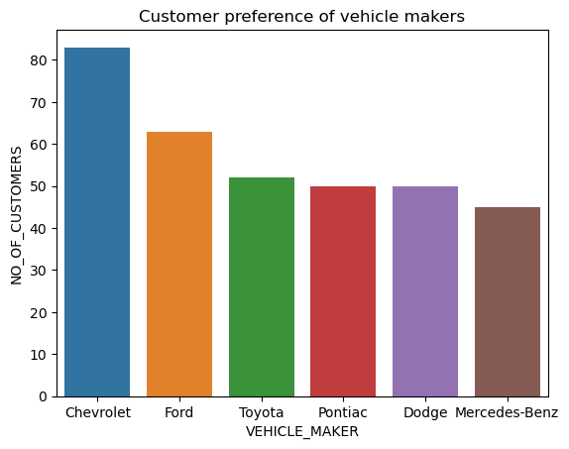
TOP VEHICLE MAKERS PREFERRED BY CUSTOMERS
OBSERVATIONS AND FINDINGS
Across the last four quarters the most popular vehicles according to customer choices can be seen in the attached plot.
Chevrolet enjoys a significantly higher popularity compared to other brands that can be seen here.
The company must undertake efforts to promote other brands among the future customers and also try to exploit the existing popularity of the above six brands by providing the best possible service to the customers choosing these brands.

Slide 8
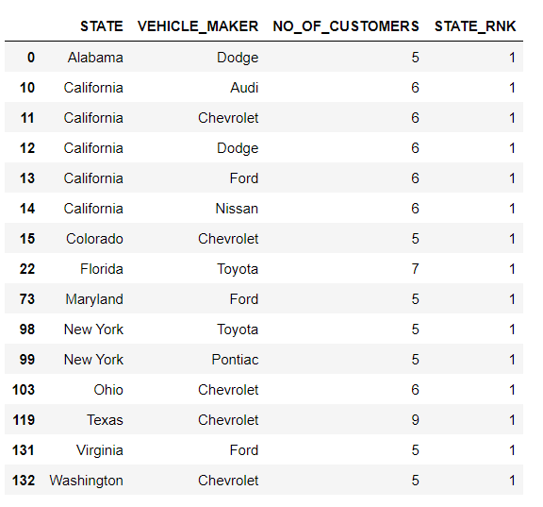
MOST PREFERRED VEHICLE MAKER IN EACH STATE
OBSERVATIONS AND FINDINGS
In the attached table we can only those states where the most popular vehicles among customers have at least 5 customers.
Based on the information obtained from these table the company can do a statewise strategic campaigning for specifically these brands of vehicles in these states to exploit their statewise popularity.
Also the features of statewise less popular cars should be brought to notice so as to improve their popularity to a certain extent so that they also can contribute to the revenue more significantly in the future quarters than what they are doing now.

Slide 9
REVENUE METRICS

Slide 10
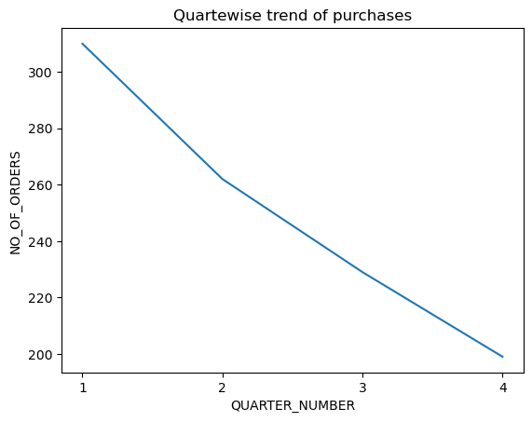
TREND OF PURCHASES BY QUARTER
OBSERVATIONS AND FINDINGS
The number of orders placed in every quarter has been significantly lower than that for the previous quarter.
This has also been a contributing factor responsible for the company’s decline in the last few quarters and must be considered seriously for restoring the status of business.

Slide 11
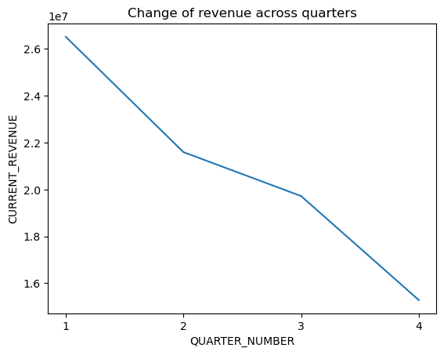
CHANGE OF REVENUE ACROSS QUARTERS
OBSERVATIONS AND FINDINGS
The revenue earned by the company has progressively reduced from the first to the last quarter as a consequence of the reduction in the number of orders as seen in the previous slide.
The company must ensure more order placements to be able to generate more revenue.

Slide 12
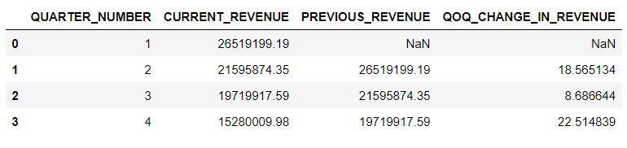
CHANGE OF REVENUE ACROSS QUARTERS
OBSERVATIONS AND FINDINGS
The maximum percentage decrease in revenue was observed during the transition from the 3rd quarter to the fourth quarter which indicates that the deterioration of the company’ s situation has happened most drastically in the recent quarter.

Slide 13
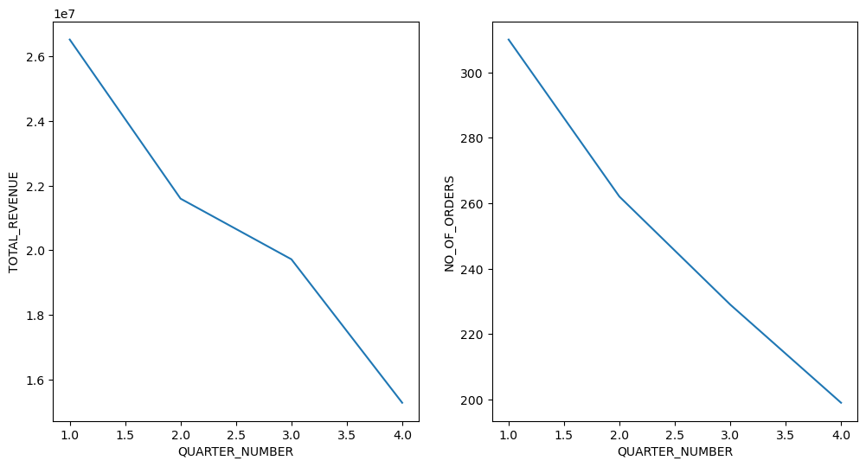
TREND OF REVENUE & ORDERS ACROSS QUARTERS
OBSERVATIONS AND FINDINGS
As already observed in two of the earlier slides, both the revenue earned by the company and the number of orders received have consistently dipped across the four quarters and the latter may be sited as one of the main reasons for the first.
The revenue decrease rate was slightly arrested between the 2nd and the 3rd quarters inspite of dip in the number of orders in this period. This may be due to the fact that whatever limited number of orders were placed during this period were mostly highly priced orders.

Slide 14
SHIPPING METRICS

Slide 15
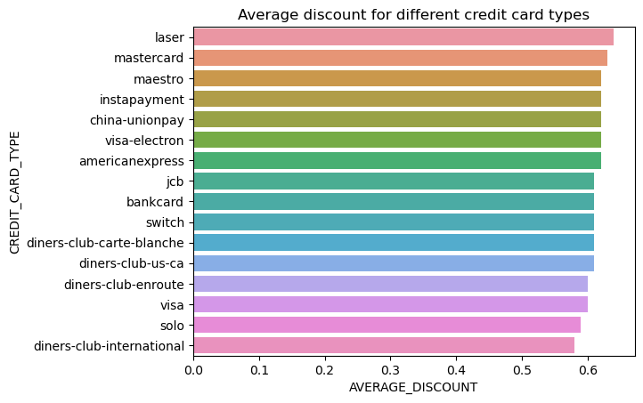
AVERAGE DISCOUNT OFFERED BY CREDIT CARD TYPE
OBSERVATIONS AND FINDINGS
The maximum discount was enjoyed by ‘laser’ credit card owners followed by those with ‘mastercard’. The customers possessing these credit cards could be targeted for better sales in future in terms of both quantity and price.

Slide 16
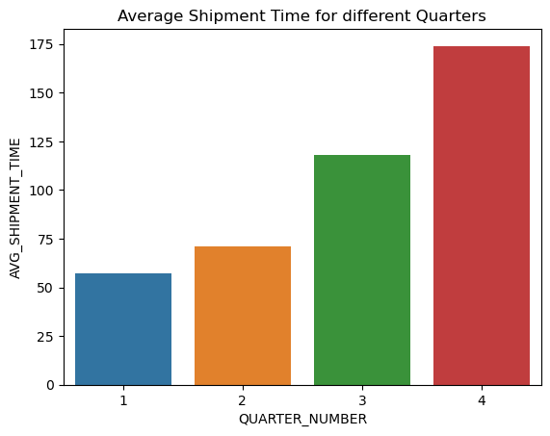
QUARTERWISE TIME TAKEN TO SHIP ORDERS
OBSERVATIONS AND FINDINGS
Finally we can see one of the major reasons behind the degradation of the company’s business and poor feedback from the customers, the average shipment time has continuously increased from the first to the last quarter.
The company must immediately take measures to bring down the average shipment time to arrest the downfall.

Slide 17
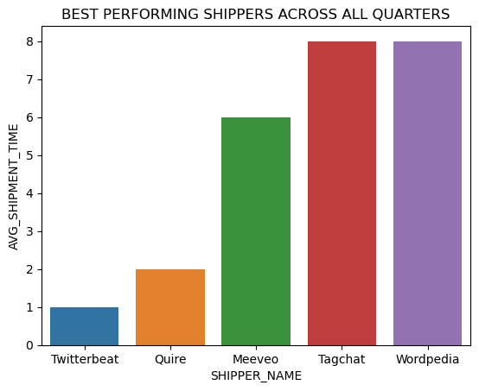
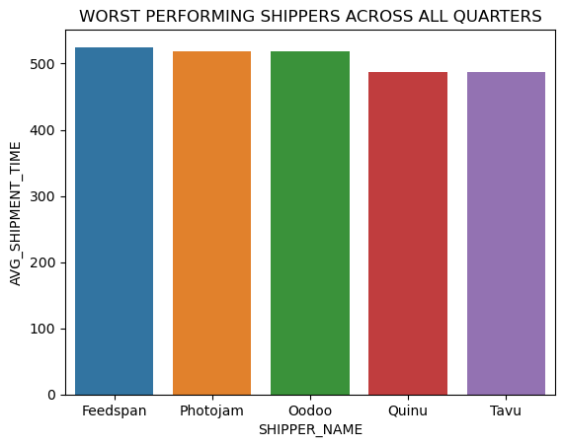
PERFORMANCE OF SHIPPERS ACROSS ALL QUARTERS
OBSERVATIONS AND FINDINGS
From the above the best performing shippers (minimum average shipment time) and the worst performing shippers (maximum average shipment time) can be identified.
Based on this information in the next quarter greater proportion of work can be handed over to the best performing shippers as they have been consistent through the last 4 quarters.
This may lead to improvement in customer satisfaction rate as lot of the poor feedbacks may be due to delayed shipment.

Slide 18
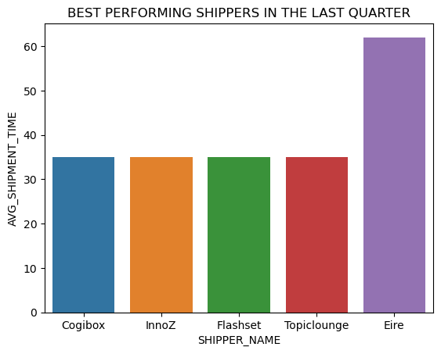
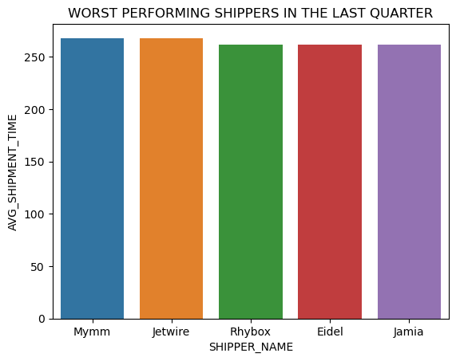
PERFORMANCE OF SHIPPERS IN THE MOST RECENT QUARTER
OBSERVATIONS AND FINDINGS
Most recent performance also matters and must be rewarded.
Therefore the company may also look to forward more number of offers to the best performing shippers in the last quarter which can be identified from the above plots in an attempt to bring down the average shipment time which can in turn address the customer feedback issues seen earlier.
The shippers who performed poorly in the last quarter as well as on an overall basis must be given feedback so that they can fix things from their end and improve their performance and reputation in future.

Slide 19
INSIGHTS AND RECOMMENDATIONS
Some of the key issues that the company can address in order to improve its performance in the upcoming quarter(s) are as follows:
The company must do the needful for extending its customer base beyond the states of California, Texas, Florida, New York and District of Columbia without losing its popularity in the mentioned states.
The customer feedback has progressively deteriorated across the last 4 quarters. All identified factors leading to this (some identified in this work itself) must be immediately addressed.
The number of customers giving ‘very poor’ feedback has gone up and the number of customers giving ‘very good’ feedback has gone down progressively across quarters. Details available in these extreme feedbacks must be scanned thoroughly and corrective measures must be taken accordingly.
The company must undertake efforts to promote brands other than Chevrolet, Ford, Toyota, Pontiac, Dodge, and Mercedes Benz among the future customers and also try to exploit the existing popularity of the above six brands by providing the best possible service to the customers choosing these brands.
Based on the information obtained from this analysis the company can do a statewise strategic campaigning for specifically the brands of vehicles in the states where they are most popular to exploit their statewise popularity.
Also the features of statewise less popular cars should be brought to notice of potential future customers so as to improve their popularity to a certain extent so that they also can contribute to the revenue more significantly in the future quarters than what they are doing now.

Slide 20
INSIGHTS AND RECOMMENDATIONS
Some of the key issues that the company can address in order to improve its performance in the upcoming quarter(s) are as follows:
The no of orders placed and hence the revenue have gone down continuously across the four quarters. Therefore efforts must be made to achieve more orders from potential customers (and if possible orders with high price tag) in order to increase the revenue.
The credit cards which are offering the highest discount to its users have been identified in this analysis. People possessing these credit cards could be targeted as potential customers.
It was found that the average shipment time of products have gone up consistently across the last 4 quarters. With this information in hand the data was analysed further and the best and worst performing shippers were identified both for the last quarter and on an overall basis. Appropriate changes may be made in terms of the shipping partner for a large majority of the orders in the future to improve customer satisfaction.

Slide 21
THANK YOU

